Slide 1
Face Recognition Via Sparse-Representation Classification
Group 5:
Mingrui Yang, Sang Jae Park, Anrui Wang

Slide 2
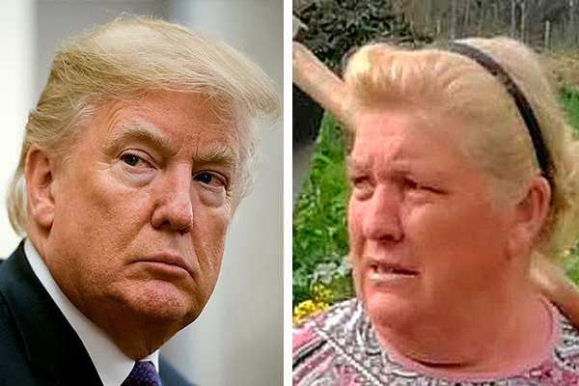
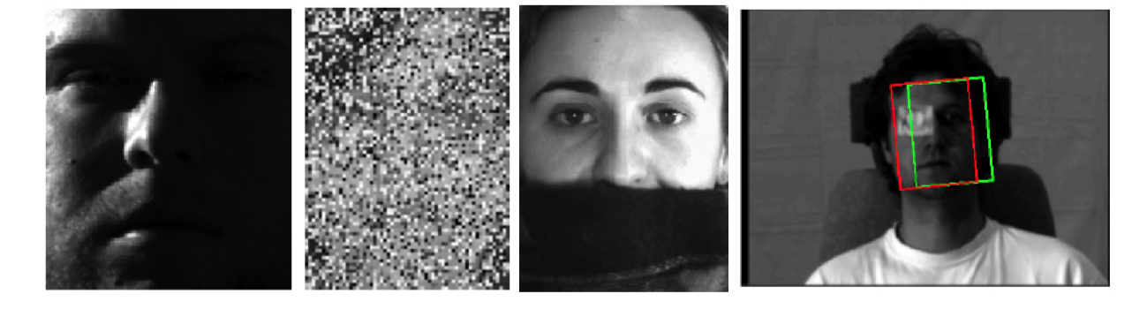
introduction
Face is a complex varied high dimensional pattern.
Great deal of potential application
https://www.youtube.com/watch?v=FYsCoHJvoWI
Notes:
Have you ever seen or meet someone, who looks like same your face?
Face is a complex varied high dimensional pattern.
This techniques are believed having a great deal of potential application in public security, law enforcement, information security, and etc.
Walmart already used facial recognition technology to catch shoplifters

Slide 3
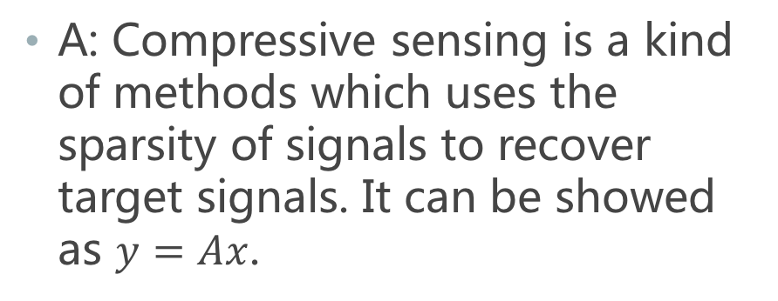
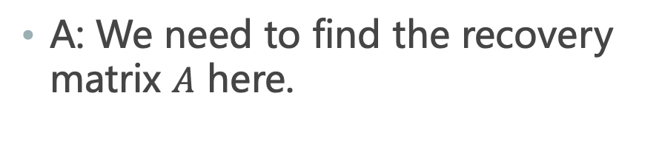
Background: Compressive Sensing
Q: What is compressive sensing?
Q: What is the prerequisite of compressive sensing?
A: Compressive sensing is a kind of methods which uses the sparsity of signals to recover target signals. It can be showed as $y=Ax$.
A: We need to find the recovery matrix $A$ here.
Many Signals. (Ex image signal after Discrete Cosine Transformation are sparse)
Notes:
A1: A: Compressive sensing is a kind of methods which uses the sparsity of signals to recover target signals. It can be showed as $y=Ax$.
A2: A: We need to find the recovery matrix $A$ here, which is called dictionary.

Slide 4
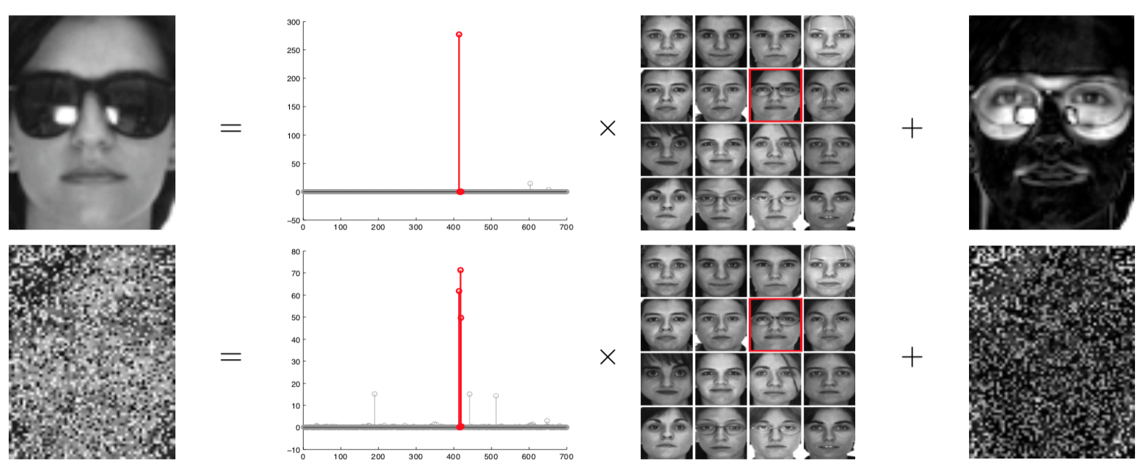
Background: What is SR?
Recovery problem in compressive sensing and sparse representation are the same problem essentially.
Be attributed to y = Ax with constraints. (which A is called dictionary)
Notes:
Sparse representation and the recovery problem in compressive sensing are the same problem essentially.
Because they can be attributed to 𝑦 = 𝐴𝑥 with constraints. In compressive sensing, we called A as measurement matrix but in sparse representation, we call it dictionary.

Slide 5
WHY src?
Sparse representation is based on optical model. In other words, in SRC (Sparse Representation based Classification) we can represent one person’s face in a linear combination of all his faces under different light conditions and at different orientations. The coefficient of other person’s face would be zero in theory.
As the data set (a linear combination of different people’s faces) growing larger, the coefficient matrix of any person will be sparse.
Notes:
Sparse representation is based on optical model. In other words, in SRC (Sparse Representation based Classification) we can represent one person’s face in a linear combination of all his faces under different light conditions and at different orientations. The coefficient of other person’s face would be zero in theory.
As the data set (a linear combination of different people’s faces) growing larger, the coefficient matrix of any person will be sparse.
SRC is robust with random noise. Even if 80% face is disturbed by random noise, SRC has an acceptable accuracy. Another pro is when some part is covered, e.g. wearing glasses and scarves, SRC also can work well.

Slide 6
Advantage of src?
Advantage 1: SRC has high robustness.
Research shows that even 80% of human face image is noised by random noise, SRC still has a high recognition rate. (Ex. one person are wearing scarf)
Advantage 2: Don’t need to train a huge data set.
The dictionary used by SRC is all training images after aligned, which is a matrix of training data set.
Notes:
Advantage 1: SRC (Sparse Representation based Classification) has high robustness. Research shows that even 80% of human face image is noised by random noise, SRC still has a high recognition rate. Moreover, even there are some overlays in the image, for example one person are wearing scarf in the image, SRC still has a high recognition rate. Those two features are characteristics of SRC.
Advantage 2: Compared with methods of machine learning, SRC has advantage that it don’t need to train a huge data set, which will cost several days even months in machine learning methods like neural networks. In some problems SRC need to be modified a little to implement an easy and quick training. The dictionary used by SRC is all training images after aligned, which is a matrix of training data set. Since L0 problem is an NP hard problem, we will use L1-minimization here.

Slide 7




Data set
Data Set we use: ORL face lib!
ORL face lib contains a set of face images taken between 1992 to 1994 by Cambridge University Computer Lab. There are 10 different images of each person and the whole data set contains images of 40 different people. We choose 7 as training samples in each class and the left 3 are test samples.

Slide 8
Recovery problem
Sparse representation and the recovery problem are the same problem.
As we have learnt L0, L1 and L2 norm minimization, we considered them all.
If we determine the solution by calculate the minimum L2 norm
𝑥₂ = arg min‖𝑥‖₂ subject to 𝐴𝑥 = 𝑦.
We find that the resolved x is too dense and hard to classify.

Slide 9
Recovery problem
If we determine the solution by calculate the minimum L0 norm,
𝑥₀ = arg min‖𝑥‖₀ subject to 𝐴𝑥 = 𝑦.
Then the result is sparsest, sounds good,
BUT the procedure is NP-hard.
Thus we choose to calculate the minimum L1 norm.
𝑥₁ = arg min‖𝑥‖₁ subject to 𝐴𝑥 = 𝑦.
L1 norm can be resolved by standard linear programming tool for polynomial. It will be more efficient if the resolution is sparse. There is noise in the real data, 𝐴𝑥₀ + 𝑧 = 𝑦, So, x can be resolved by approximate solution of L1 norm.

Slide 10
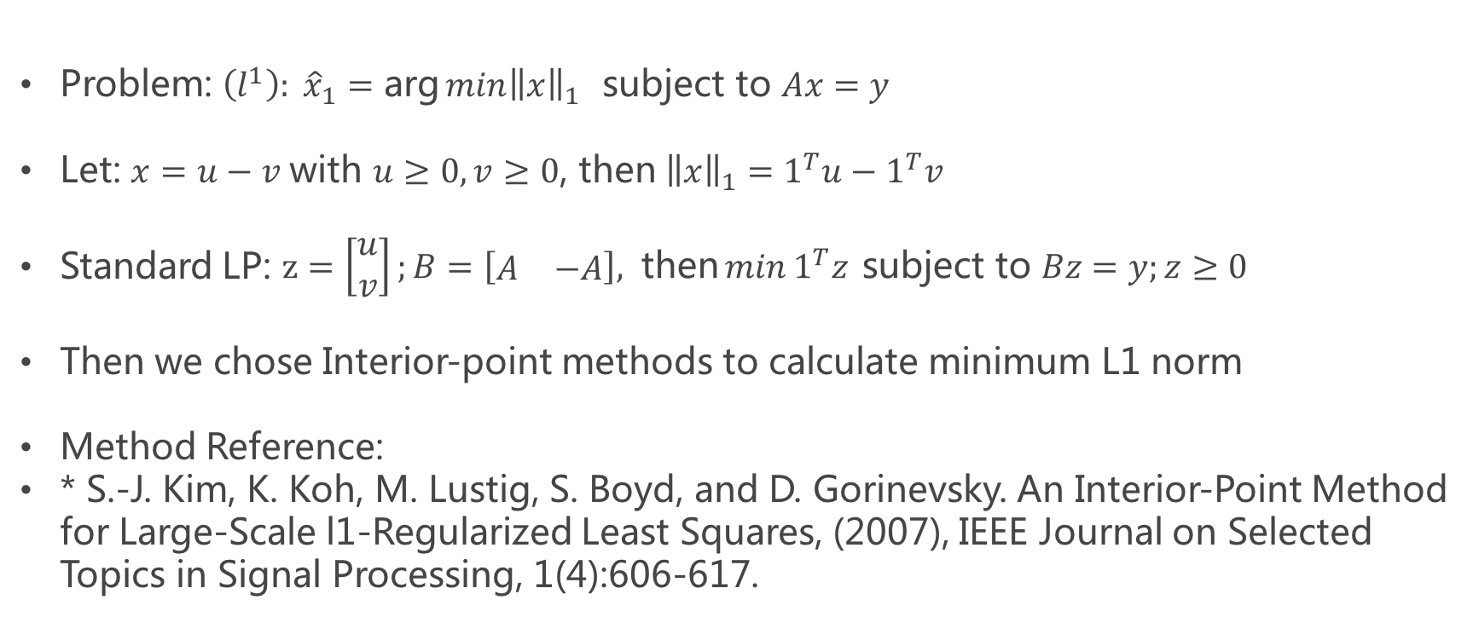
Calculate minimum L1 norm
Problem: $\left(l^{1}\right): {\hat{x}}_{1}=\text{arg}\min{{\left\|x\right\|}_{1}} \text{subject} \text{to} Ax=y$
Let: $x=u−v \text{with} u≥0, v≥0\text{, }\text{then} {\left\|x\right\|}_{1}=1^{T}u−1^{T}v$
Standard LP: $z=\left[\begin{matrix}u \\ v\end{matrix}\right];B=\left[\begin{matrix}A & −A\end{matrix}\right], \text{then}\min{1^{T}z} \text{subject} \text{to} Bz=y;z≥0$
Then we chose Interior-point methods to calculate minimum L1 norm
Method Reference:
* S.-J. Kim, K. Koh, M. Lustig, S. Boyd, and D. Gorinevsky. An Interior-Point Method for Large-Scale l1-Regularized Least Squares, (2007), IEEE Journal on Selected Topics in Signal Processing, 1(4):606-617.

Slide 11
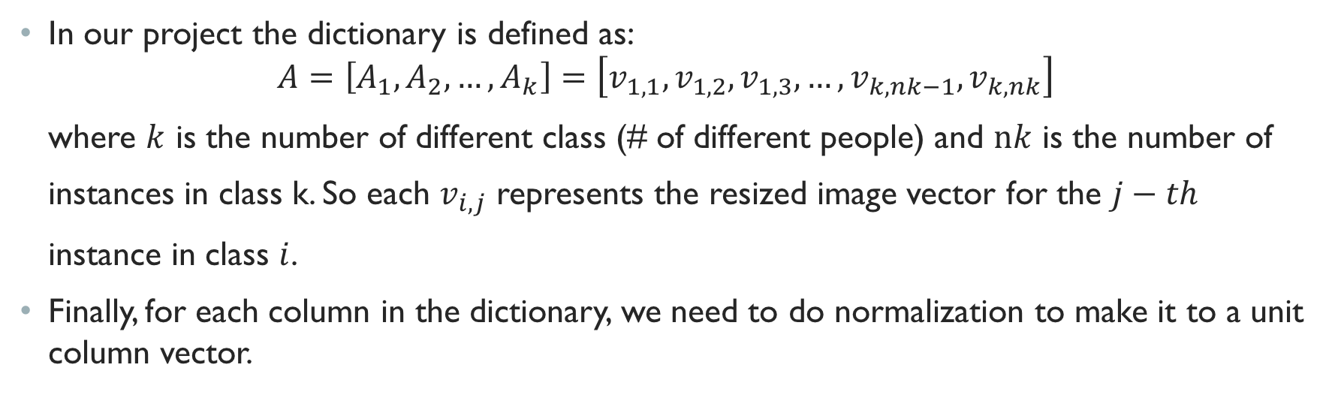
SRC Algorithm: Dictionary
Q: What is dictionary?
Q: What is the dictionary for SRC here.
A: Dictionary is a sparse representation model. It is a matrix of sampling signals (or training signals).
A: The dictionary here is just a matrix of original sampling signals under some permutation.
In our project the dictionary is defined as:
$$A=\left[A_{1},A_{2}, …,A_{k}\right]=\left[v_{1,1},v_{1,2},v_{1,3}, …,{v_{k,nk−1}, v}_{k,nk}\right]$$
where $k$ is the number of different class (# of different people) and $nk$ is the number of
instances in class k. So each $v_{i,j}$ represents the resized image vector for the $j−th$
instance in class $i$.
Finally, for each column in the dictionary, we need to do normalization to make it to a unit column vector.
Notes:
A1: Dictionary is a sparse representation model. It is a matrix of sampling signals (or training signals). Sometimes we need to do some transformations to those original sampling signals to construct the dictionary according to certain problem.

Slide 12
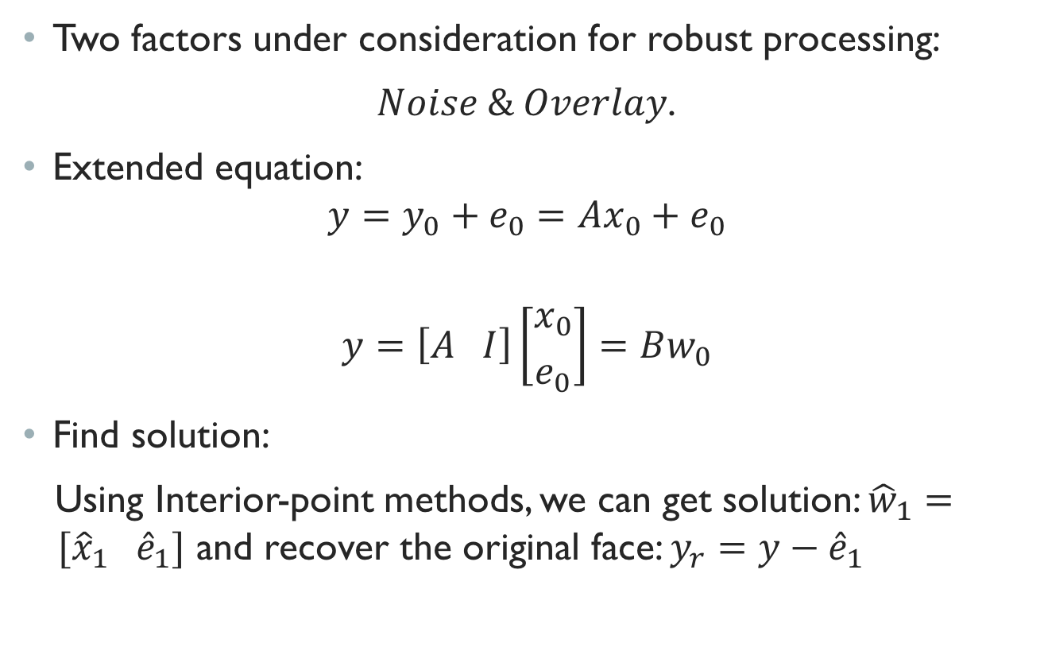
SRC Algorithm: Robust processing
Two factors under consideration for robust processing:
$Noise \& Overlay$.
Extended equation:
$$y=y_{0}+e_{0}=Ax_{0}+e_{0}$$
$$y=\left[A I\right]\left[{x_{0} \atop e_{0}}\right]=Bw_{0}$$
Find solution:
Using Interior-point methods, we can get solution: ${\hat{w}}_{1}= [{\hat{x}}_{1} {\hat{e}}_{1}]$ and recover the original face: $y_{r}=y−{\hat{e}}_{1}$
Extend

Slide 13
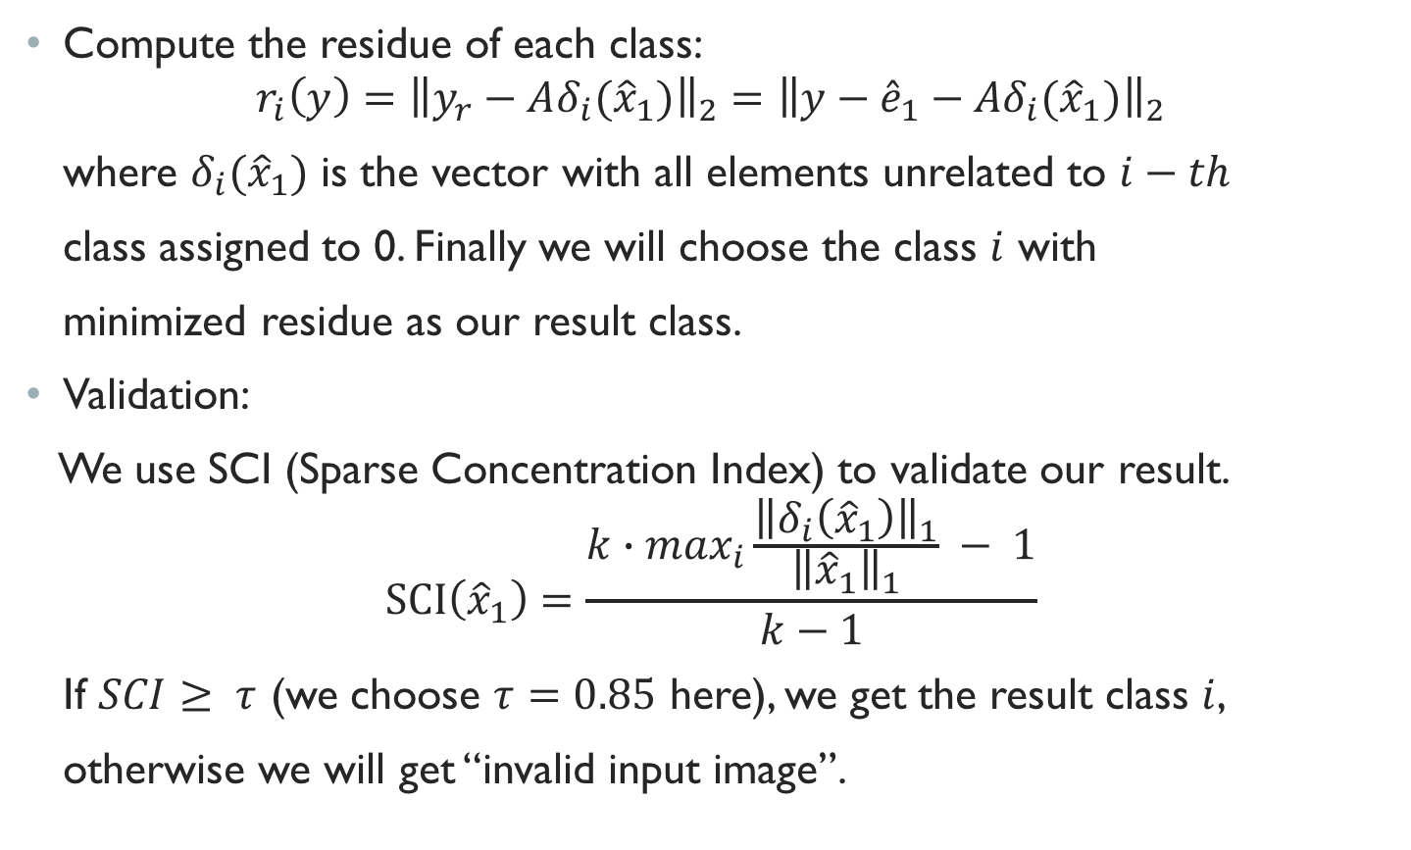
SRC Algorithm: Residue and validation
Compute the residue of each class:
$$r_{i}\left(y\right)={\left\|y_{r}−Aδ_{i}({\hat{x}}_{1})\right\|}_{2}={\left\|y−{\hat{e}}_{1}−Aδ_{i}({\hat{x}}_{1})\right\|}_{2}$$
where $δ_{i}({\hat{x}}_{1})$ is the vector with all elements unrelated to $i−th$
class assigned to 0. Finally we will choose the class $i$ with
minimized residue as our result class.
Validation:
We use SCI (Sparse Concentration Index) to validate our result.
$$\text{SCI}\left({\hat{x}}_{1}\right)=\frac{k∙\max_{i}{\frac{{\left\|δ_{i}\left({\hat{x}}_{1}\right)\right\|}_{1}}{{\left\|{\hat{x}}_{1}\right\|}_{1}} − 1}}{k−1}$$
If $SCI≥ τ$ (we choose $τ=0.85$ here), we get the result class $i$,
otherwise we will get “invalid input image”.

Slide 14
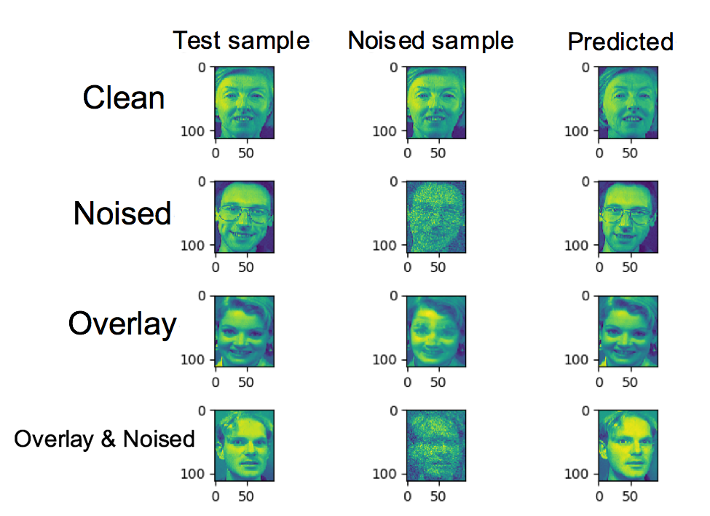
Results
We have tested
120 samples.
The accuracy is 95%.

Slide 15
Future work
Future work:
Try some better algorithms:
CRC-RLS
RASL
Robust batch Alignment of Images by Sparse and Low-Rank Decomposition
RASR
Robust Alignment and Illumination by Sparse Representation
MRR
Efficient Misalignment-Robust Representation for Real Time Face Recognition
Notes:
CRC-RLS: Use L2 to replace L1, not so sparse but focus more on classification criteria
RASL: focus on low rank decomposition to solve the problem of alignment of face
RASR: familiar with the above one
MRR: Coarse-to- fine search, based on RASR and raise the efficiency by c/2 times, as c is the number of subject.

Slide 16
Any Questions?

